Slide 1
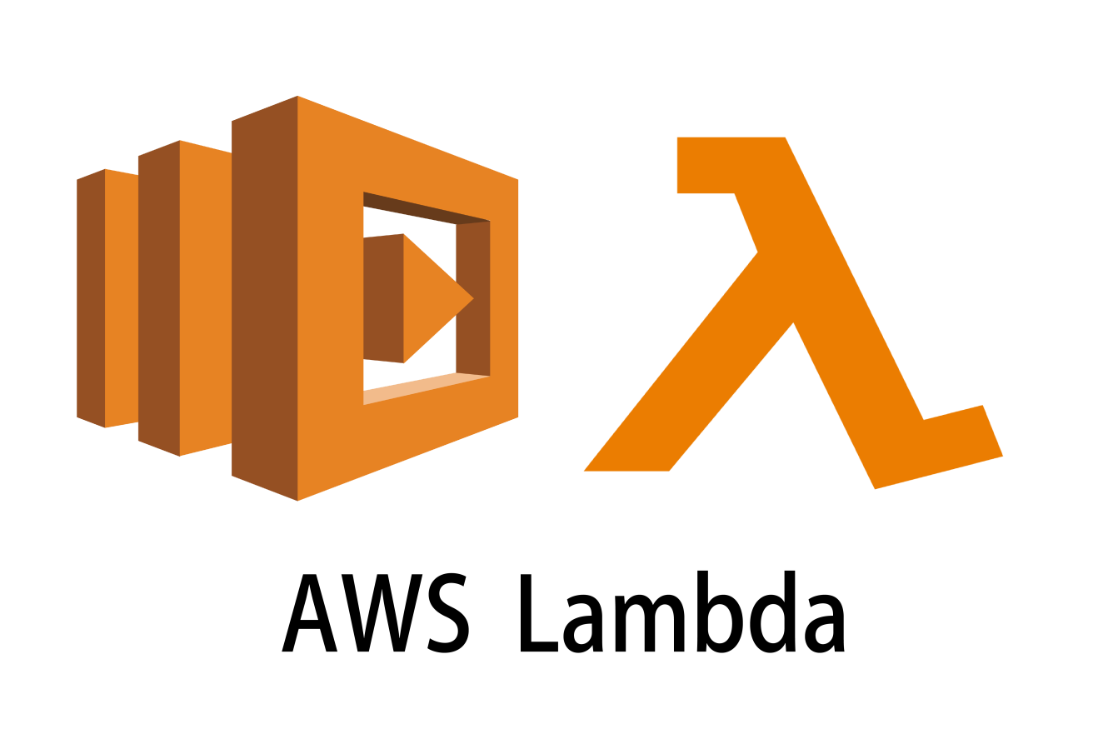
Task 8: Serverless Architecture Setup (AWS Lambda)

Slide 2
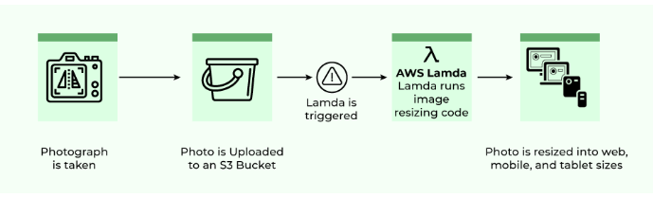
AWS Lambda
AWS Lambda is a serverless computing service that automatically runs code in response to events, without requiring you to manage the underlying infrastructure.
It supports event-driven applications triggered by events such as HTTP requests,
DynamoDB table updates, or state transitions.

Slide 3
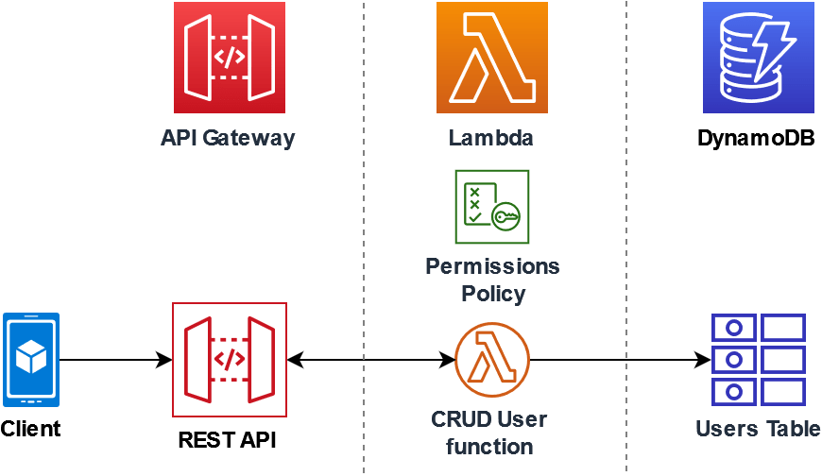

Slide 4
What are Lambdas Functions?
AWS lambda are server-less compute functions are fully managed by the AWS where developers can run there code without worrying about servers.
AWS lambda functions will allow you to run the code with out provisioning or managing servers.
Example:
Process data from Amazon S3 buckets.
Respond to HTTP requests.
Build serverless applications.

Slide 5
Use Cases of AWS Lambda Functions
File Processing: AWS lambda can be triggered by using simple storage services (S3). Whenever files are added to the S3 service Lambda data processing will be triggered.
Web Applications: You can combine both web applications and AWS lambda which will scale up and down automatically based on the incoming traffic.
IoT (Internet of Things) applications: You can trigger the AWS lambda based on certain conditions.

Slide 6
Features of AWS Lambda Functions
AutoScaling and High Availability
Serverless Execution
Pay-per-use-pricing
Supports different programming languages: Python, Node.js,Java
Integrates with other AWS Services: API Gateway, DynamoDB, S3

Slide 7
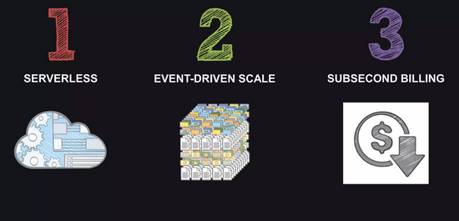
Aws lambda benefits

Slide 8
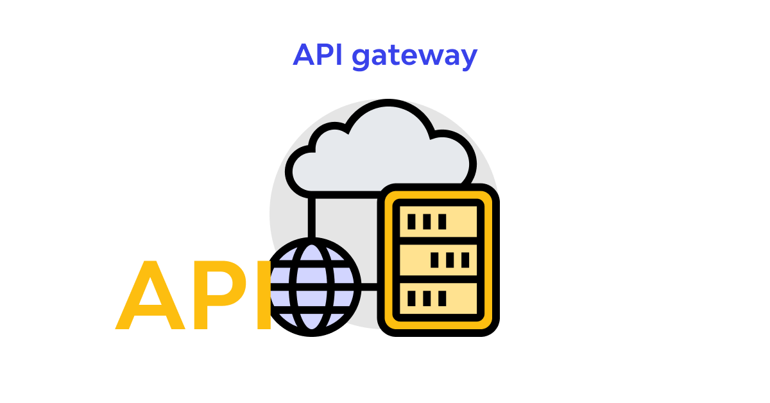
What is API Gateway
An API Gateway is a server that acts as an entry point for all client requests to a backend system, serving as an intermediary between clients and the services they wish to access.
It handles various tasks, such as routing requests, load balancing, authentication, rate limiting, caching, and more.
API gateways are commonly used in microservices architectures to provide a unified API interface and simplify management.

Slide 9
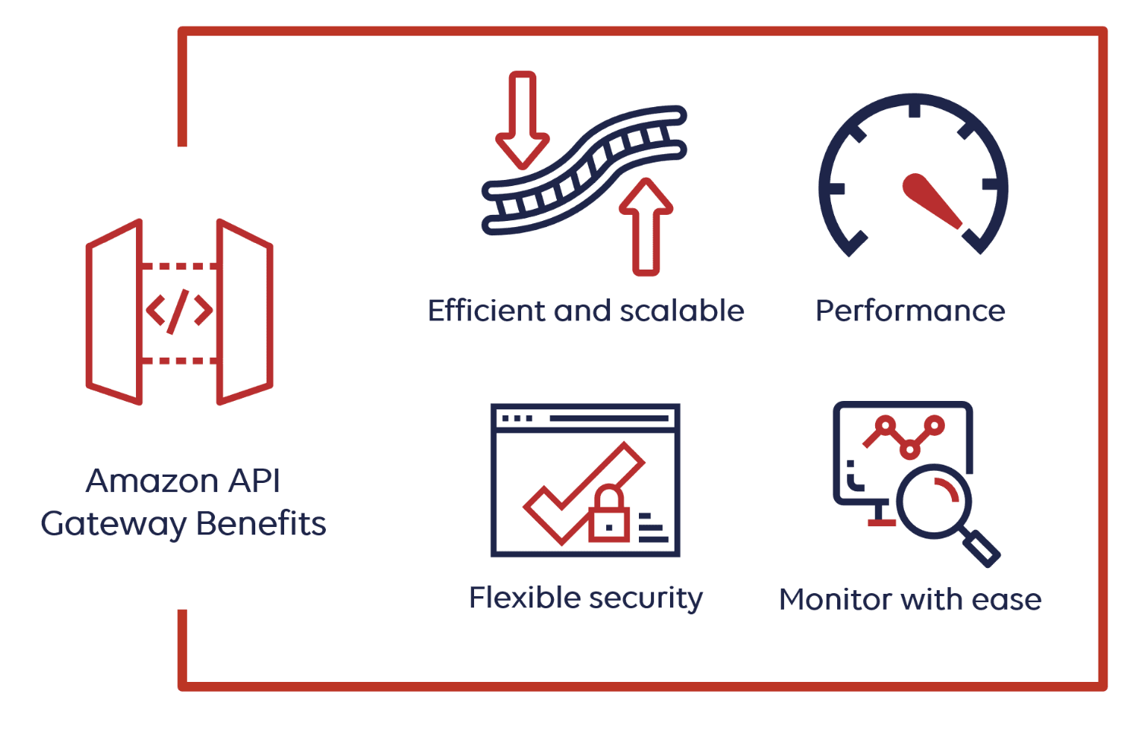
Benefits of Using an API Gateway
Simplifies Client Communication: Clients only need to communicate with the API Gateway instead of individual services.
Improves Scalability: Centralized routing and load balancing help in scaling backend services more easily.
Enhanced Security: The gateway can implement security measures like SSL/TLS encryption, API keys, OAuth tokens, etc.
Improved Developer Experience: Developers can use a single interface to interact with multiple services, which simplifies the development process.

Slide 10
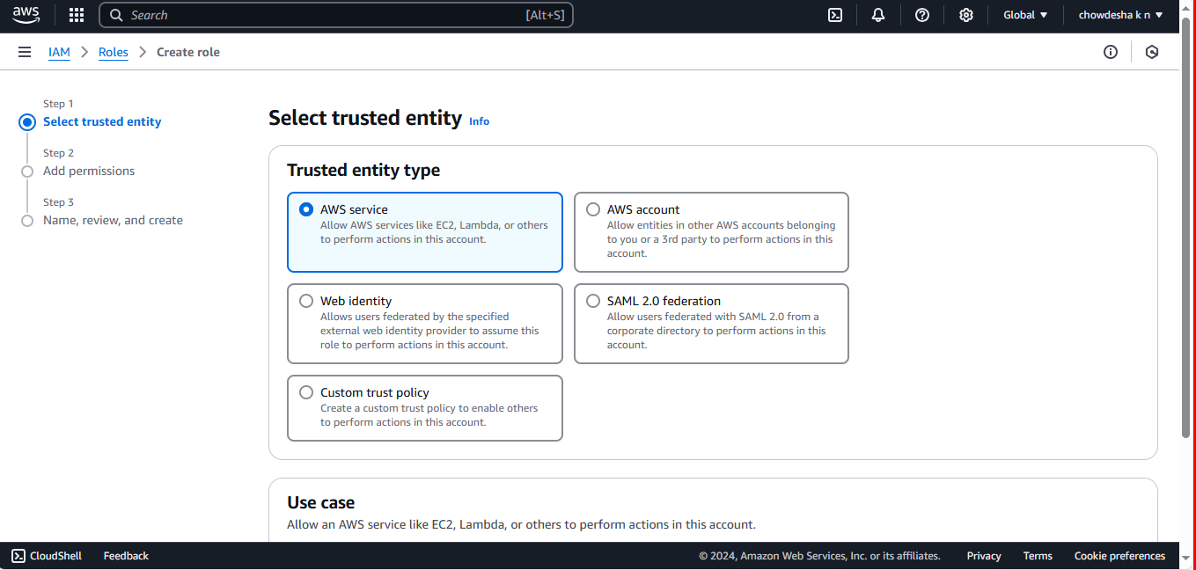
Create a role under trusted entity select aws service

Slide 11
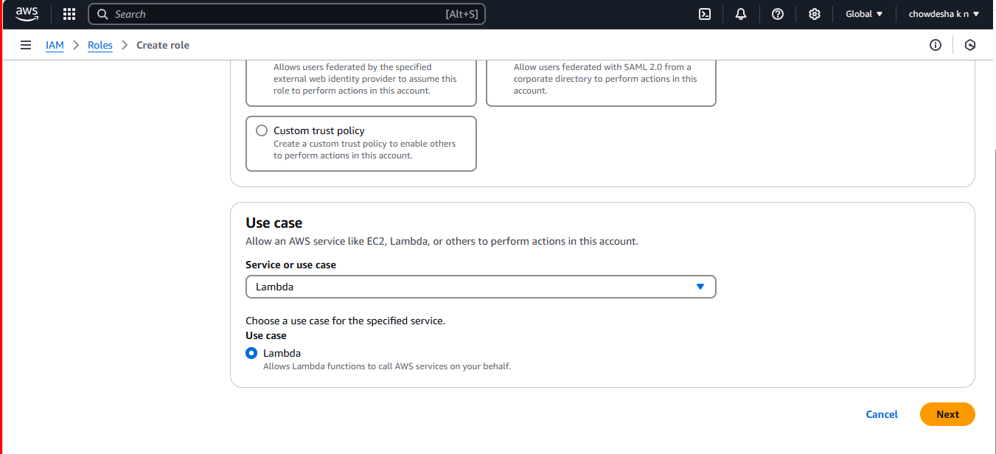
Under use case select lambda

Slide 12
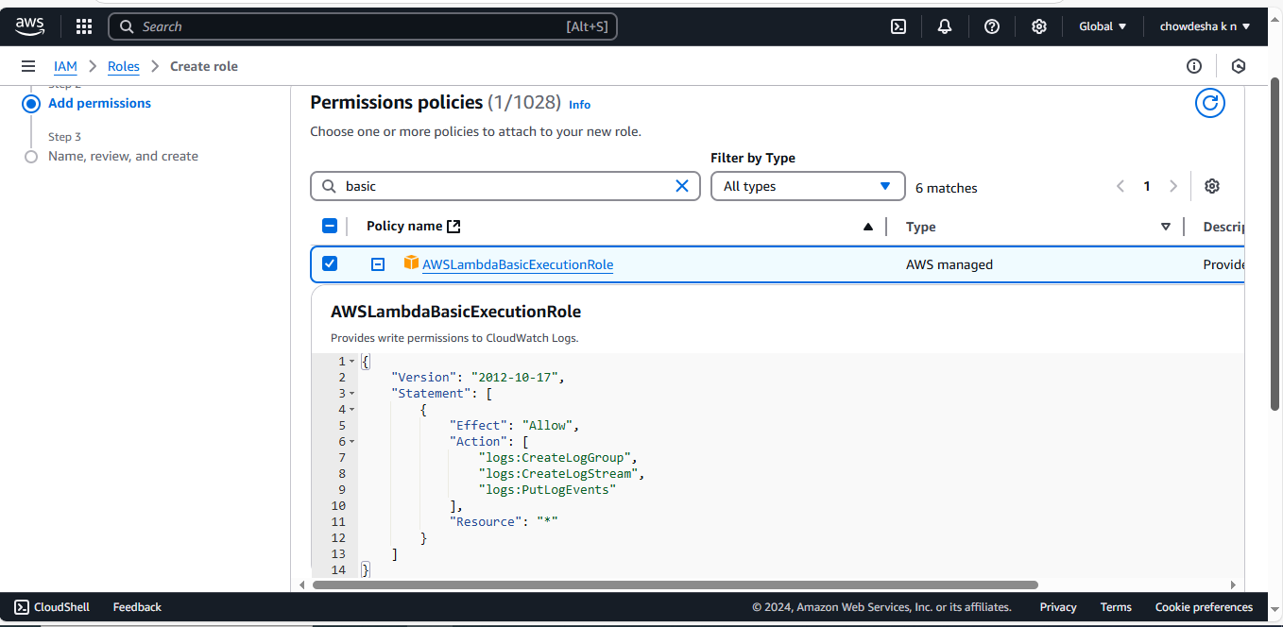
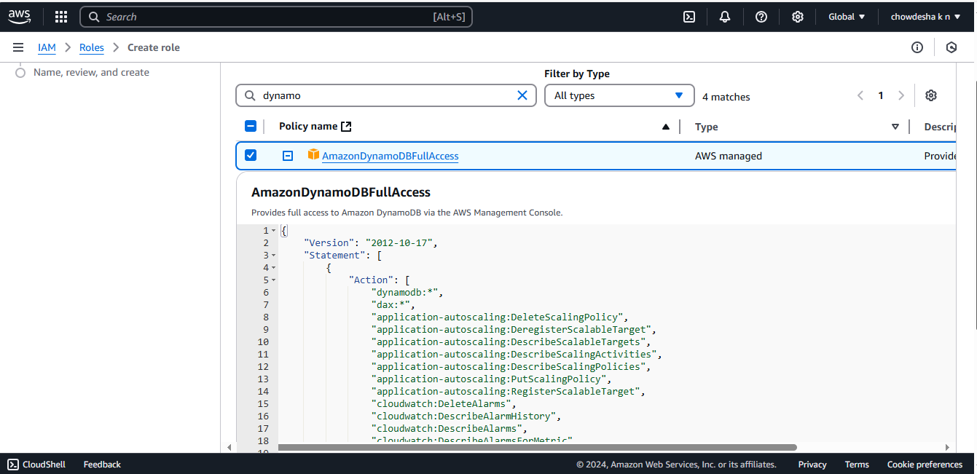
For this lambda function add AWSLambdaBasicExecutionRole and AmazonDynamoDBFullAccess policies

Slide 13
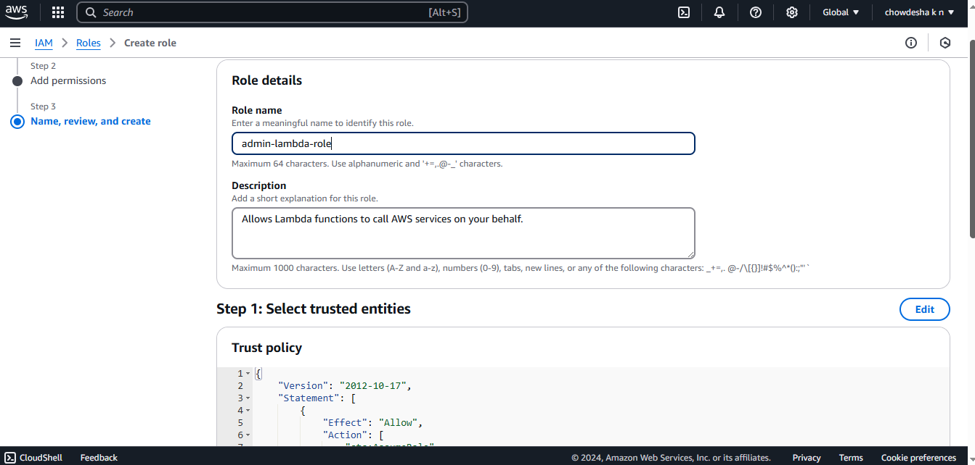
Create a role with the name as admin-lambda-role

Slide 14
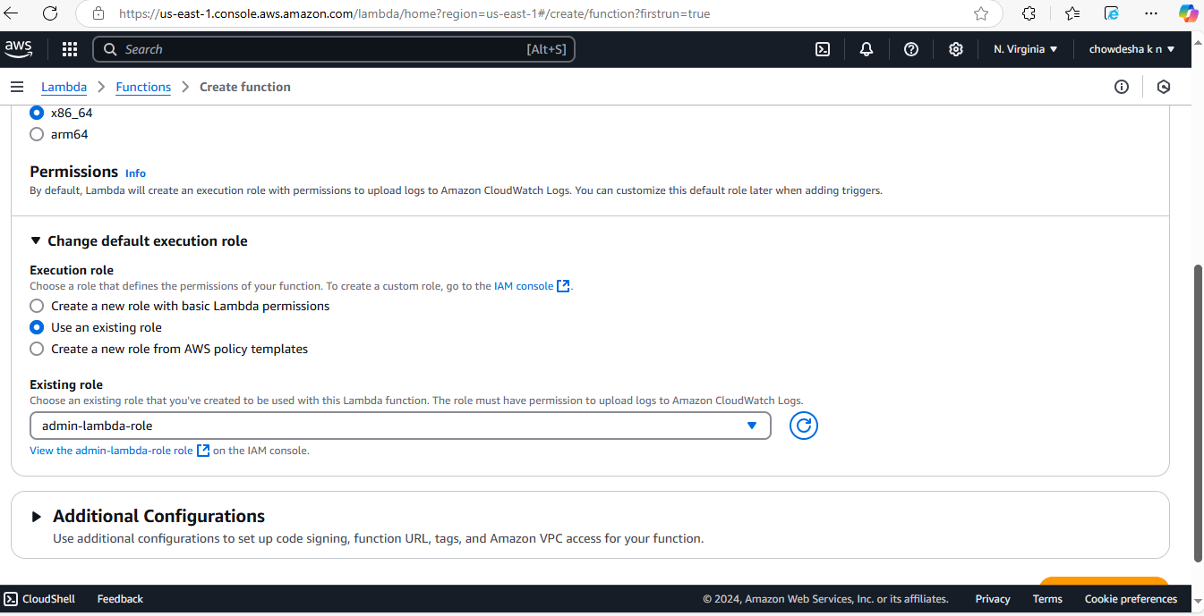
Create lambda function and select use an existing role under change default execution role

Slide 15
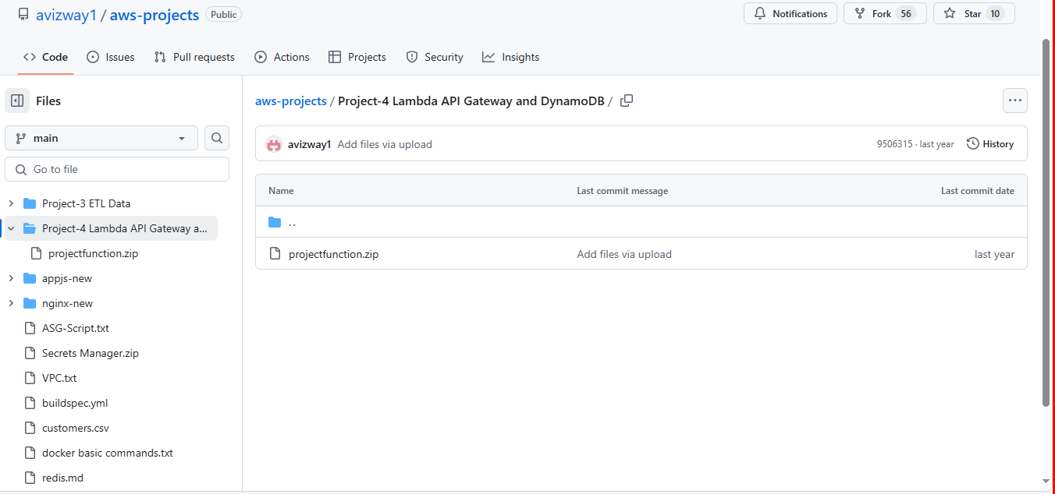
Select project-4 in the given github url and download the zip file

Slide 16
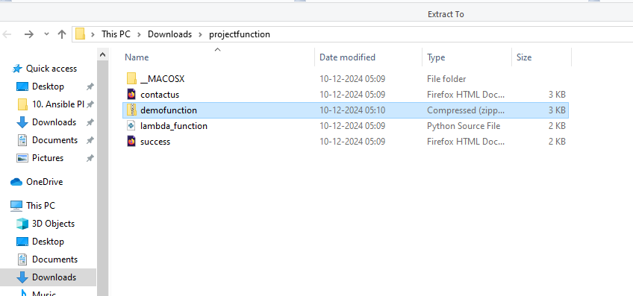
This lambda function contains 3 files which are contactus, lambda_function & success and compress all files into a single file i.e. demofunction

Slide 17
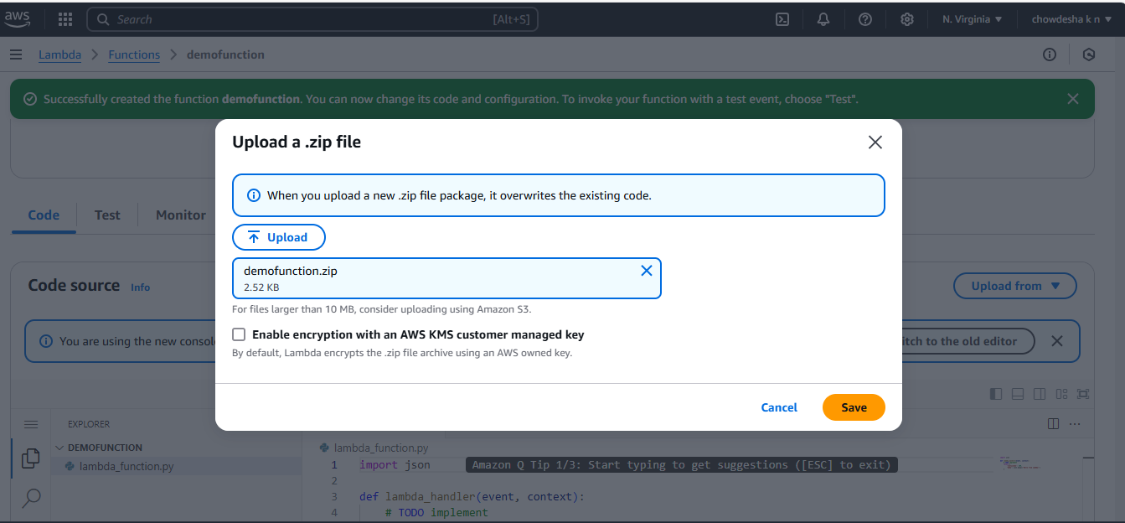
Upload the zip file

Slide 18
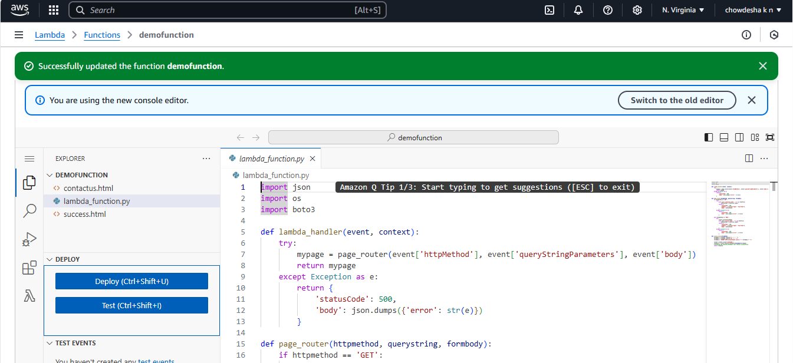
Files are successfully uploaded

Slide 19
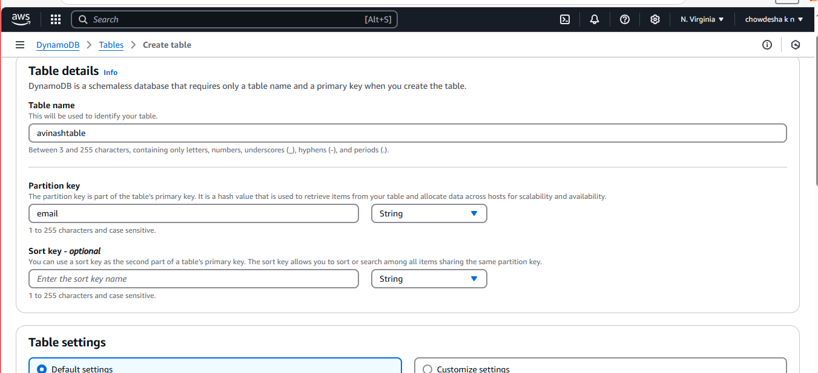
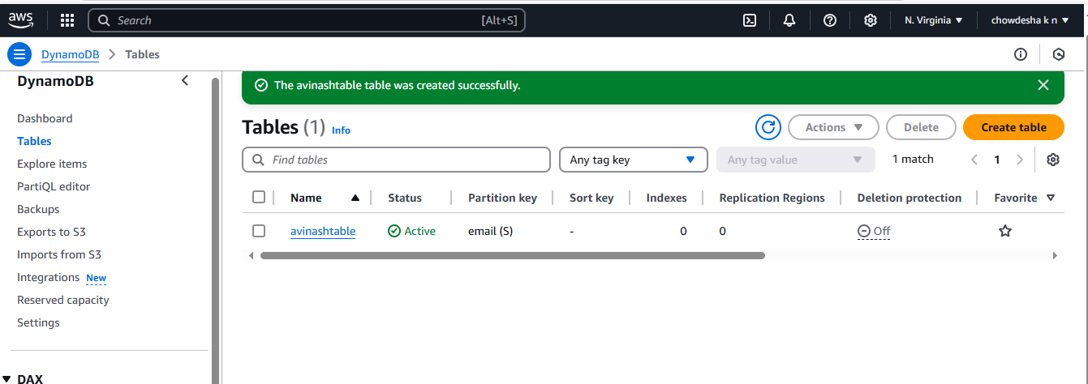
In DynamoDB go to tables then create table

Slide 20
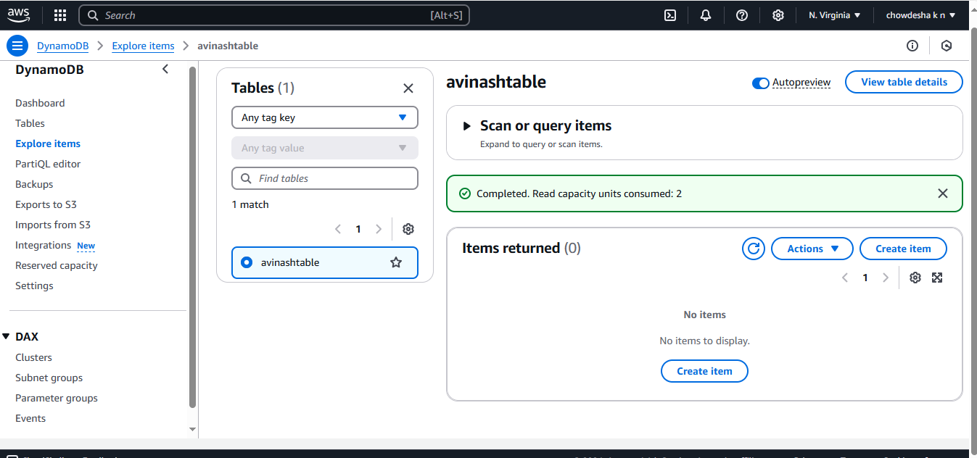
We don’t have any items in explore items

Slide 21
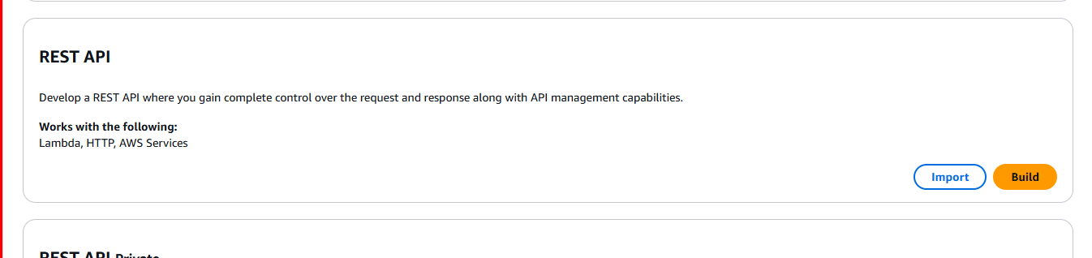
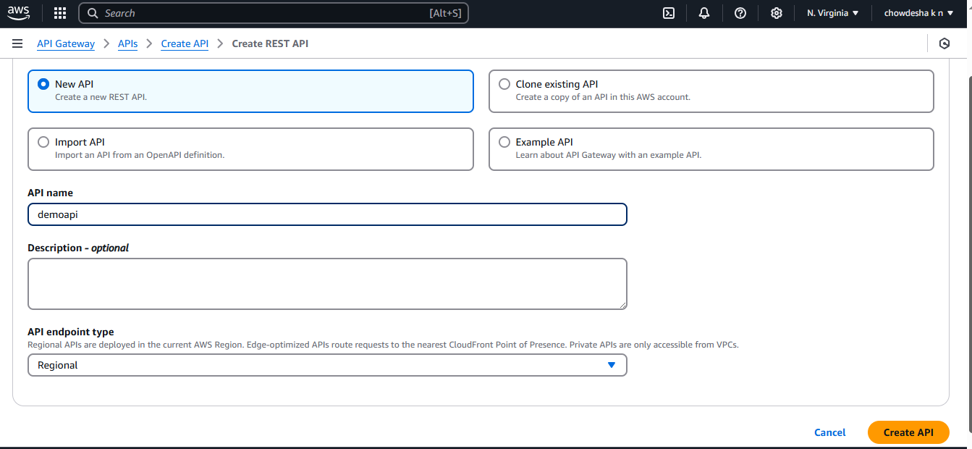
Go to API Gateway and click on build in REST API

Slide 22
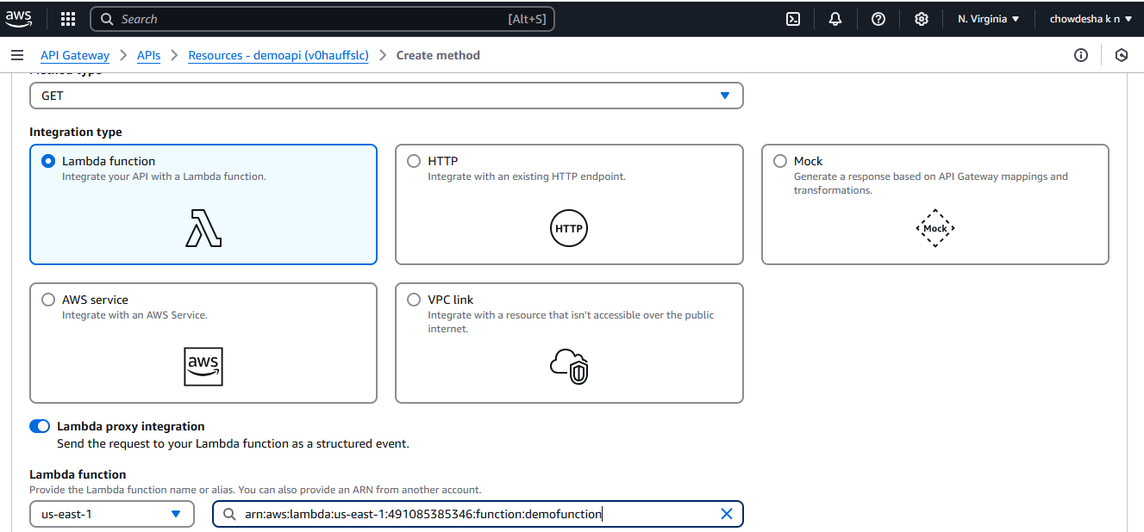
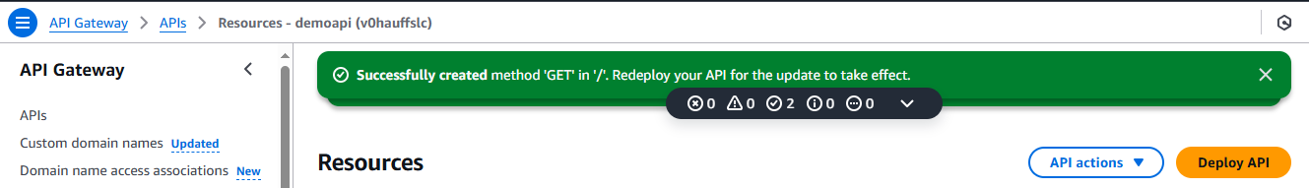
Create method under method type select GET, enable lambda proxy integration and select lambda function which we created.

Slide 23
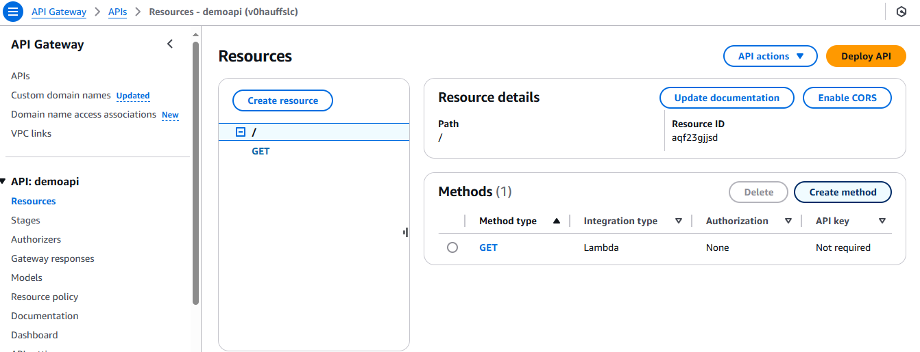
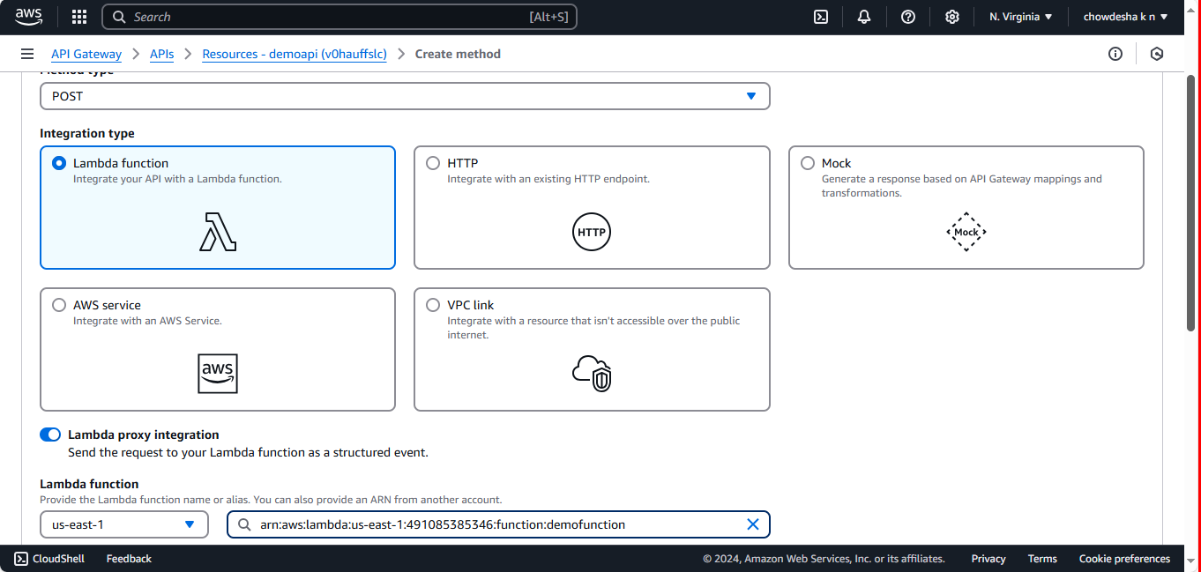
Go to this root(/) and click on create method and select method type POST, enable lambda proxy integration select lambda function which we created.

Slide 24
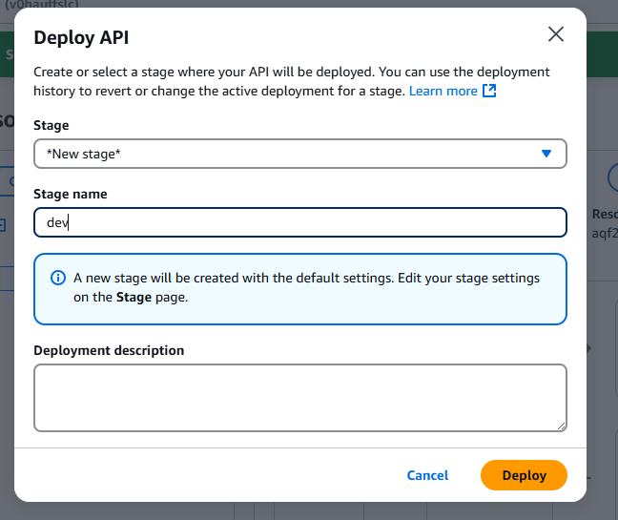
Click on Deploy API, select new stage and click on deploy

Slide 25
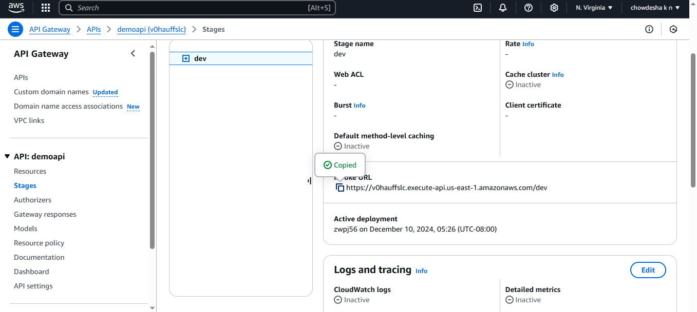
After completing deployment we get invoke url

Slide 26
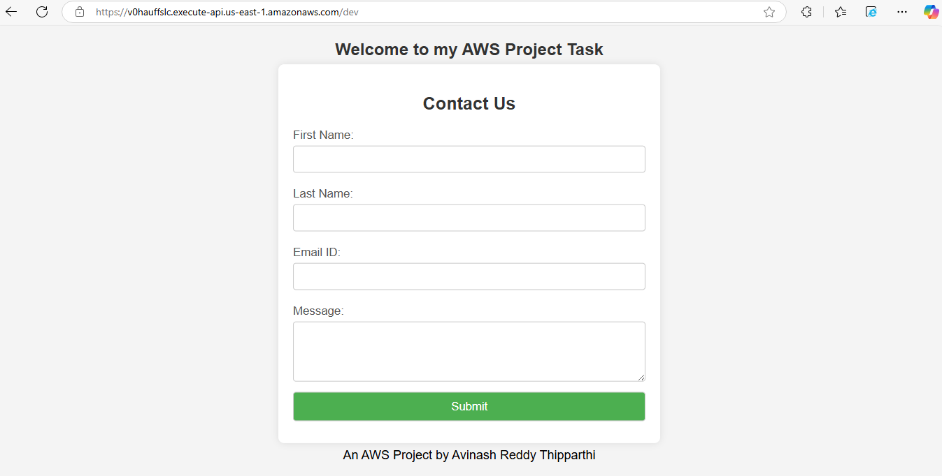
Whenever we give this invoke url in our browser it is loading this webpage

Slide 27
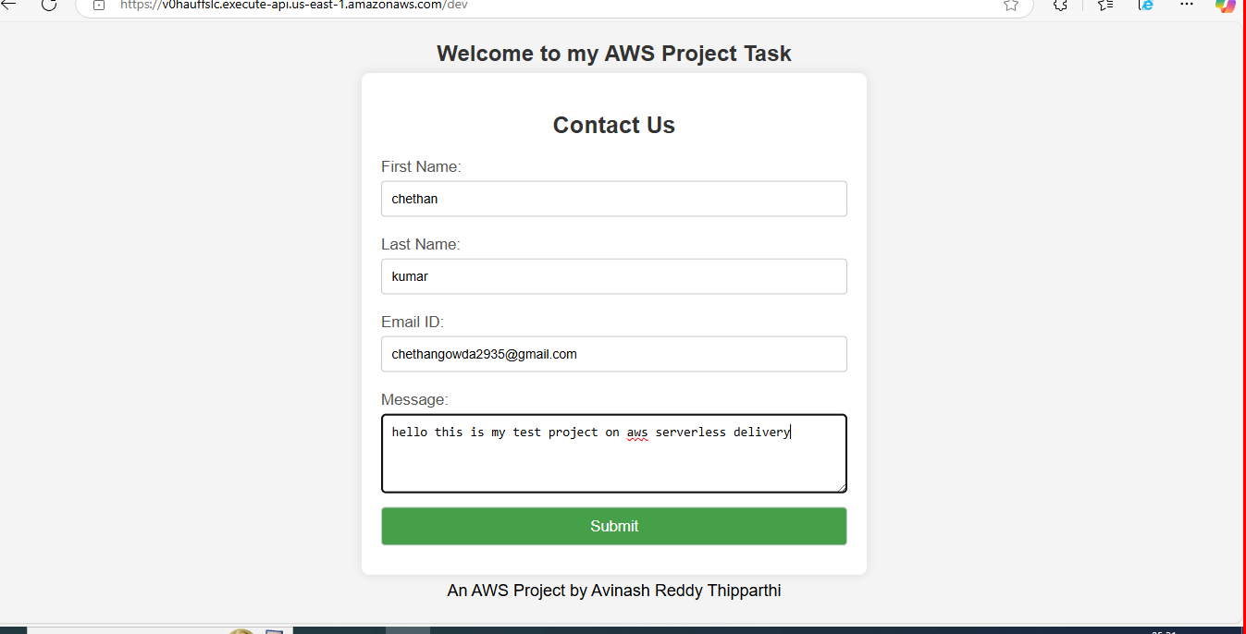
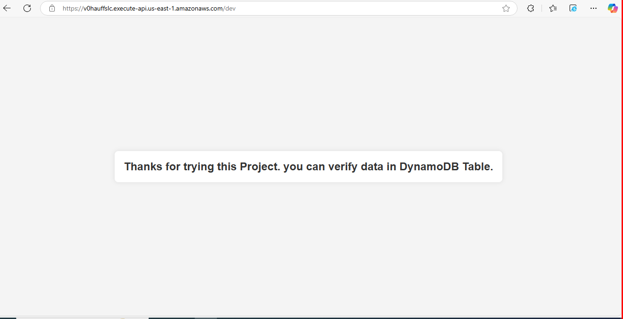
Fill some information then click on submit, data is storing in backend DynamoDB table

Slide 28
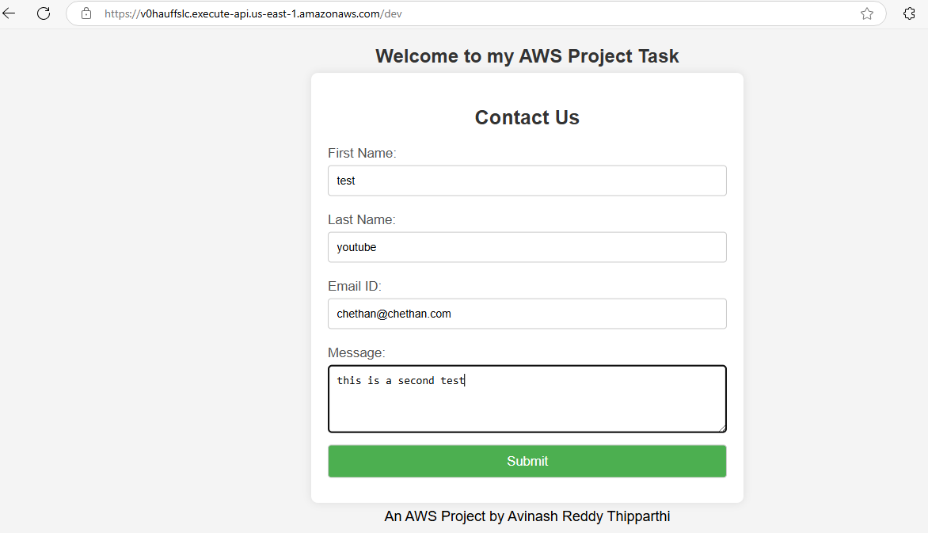
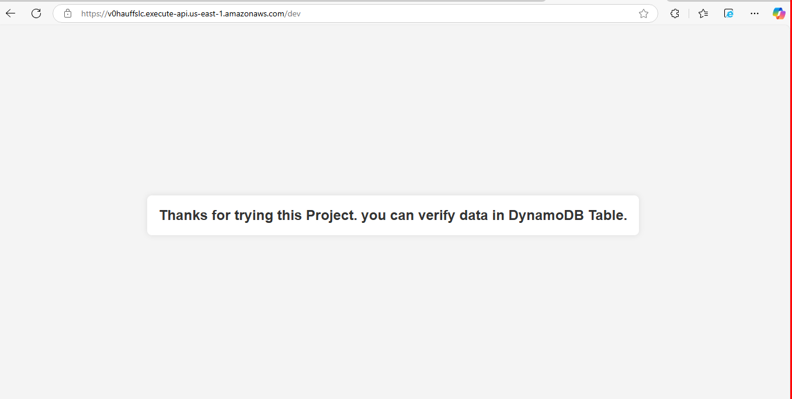
Test with another infromation

Slide 29
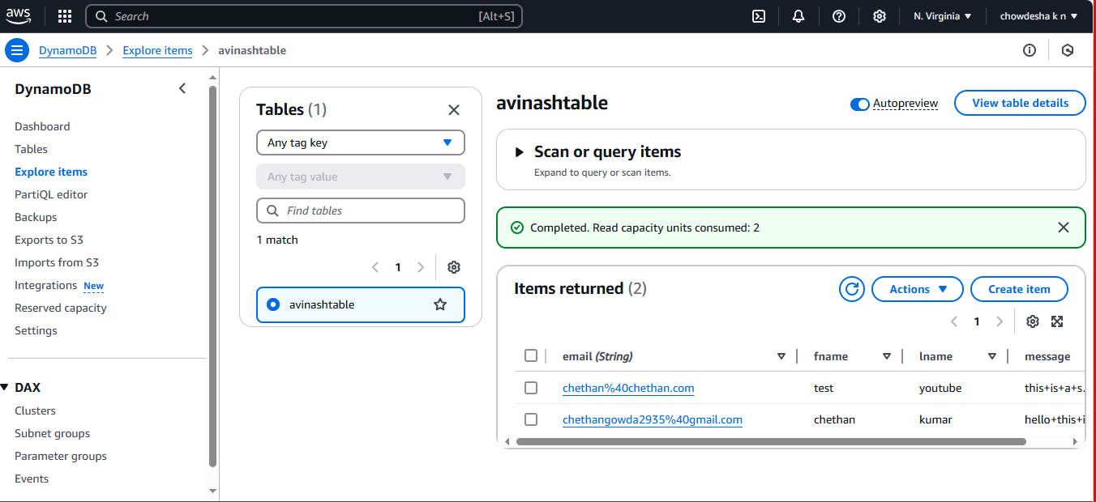
Whatever the information we filled their all infromation is storing here.

